Slide 1

Mental Arithmetic 1.
1.
2.
3.
4.
5.
6.

Slide 2
Answers
27.62
90
18
350mL
3 and 12
1:55pm

Slide 3
Time
EQ: What time facts do you need to solve problems for OLNA? How do you know how long you have worked in a week?

Slide 4
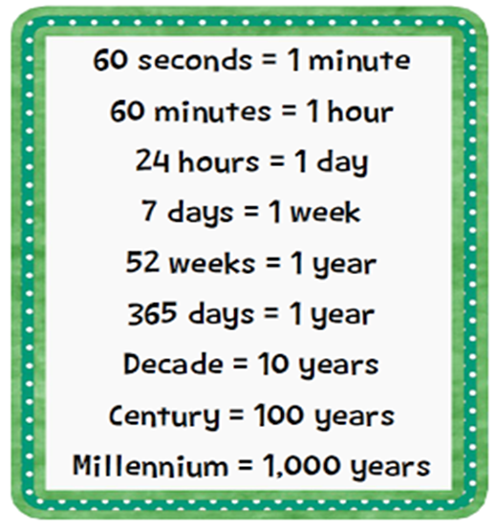
Time facts

Slide 5
OLNA Questions
How many hours in 2 days 8 hours?
How many seconds in 2 minutes 45 seconds?
How many minutes in 1.5 hours?

Slide 6
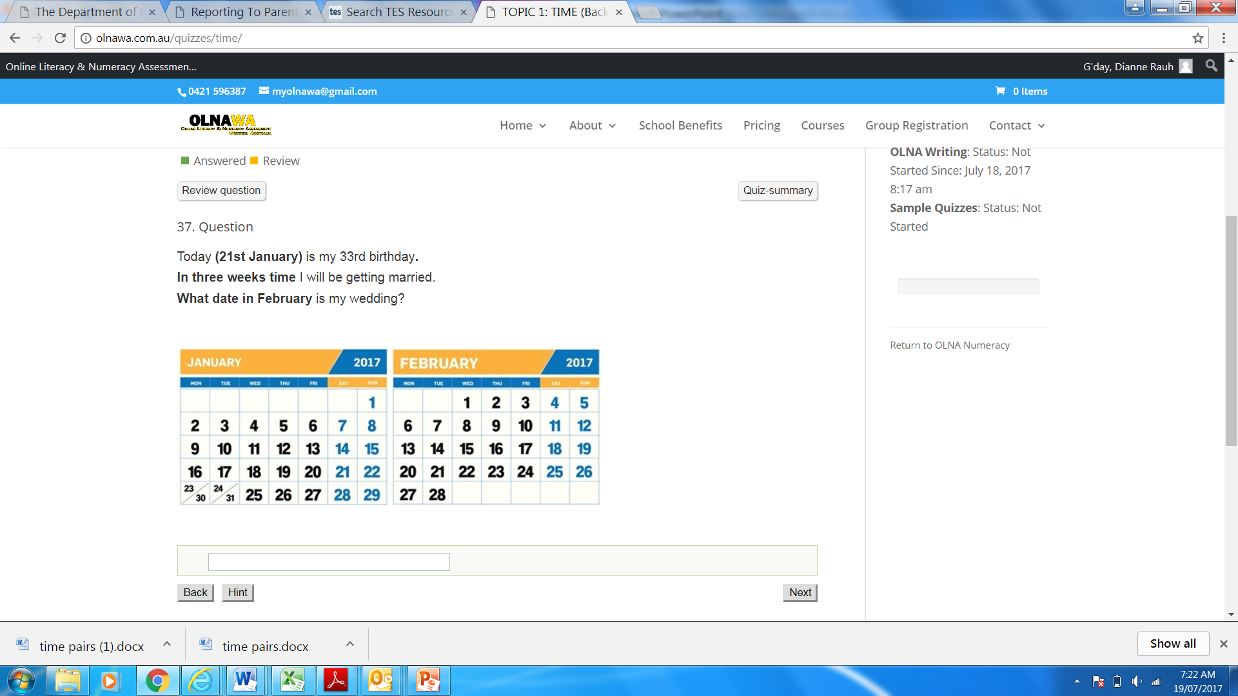

Slide 7
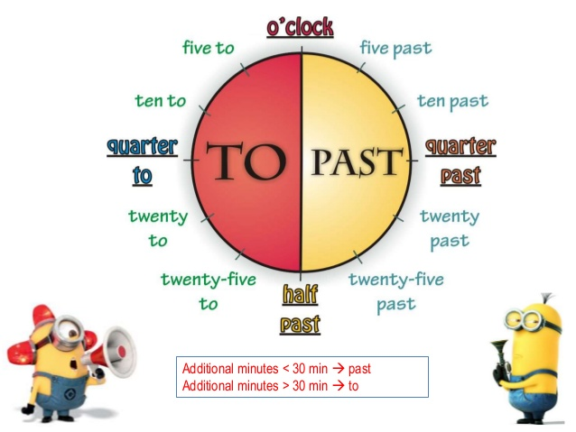
Can you tell the time?
This is how we speak time from an analogue clock.
Draw this onto the clock face hand out and stick it onto your notes page. You have 5 minutes!
HURRY UP ALREADY!!!
Notes:
Teachers to use clock on wall as well to ask students questions about time. Hand out clock sheet for students to draw this on and glue into their notebooks.

Slide 8
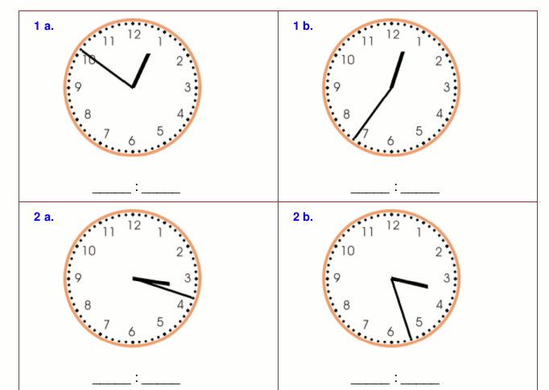
Write the digital time and say the time in words

Slide 9
CARD MATCH
Match the digital time with the analogue clock and the time written in words.
Set the timer You have 4.5 minutes. How long is that?
http://www.online-stopwatch.com/countdown-timer/

Slide 10
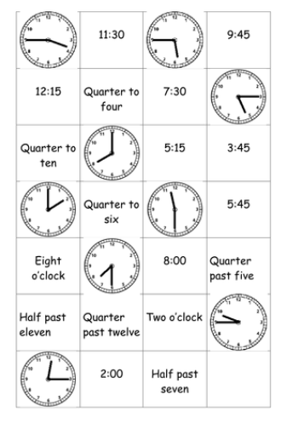

Slide 11

Elapsed time
A plane leaves Melbourne at 09:35 and arrives in Tokyo at 20:05 (Melbourne time).
How long did the flight take?
Start at 9:35 add on one hour at a time. Write the times under each arrow, until you add the next hour and it will go too far. Then start counting in 5 minute lots.

Slide 12
Your practise time
You have 6 minutes to complete the worksheet on elapsed time. Your teacher will work through the first one on the board for you. – the easy way!! Use mountains, hills, rocks (for 1hr , 10mins, 1mins)
Staple it into your note book on the LHS

Slide 13
OLNA questions
1. A hard-disc recorder was set to begin taping a show at 18:35.
It ended at 20:15. How long was the show?
2. Chloe works the following hours at her part time job on the weekend.
Sat: 9 am until 4 pm, with one hour break for lunch.
Sun: 8:30 am until 5:30 pm, with a one hour break for lunch.
For how many hours does Chloe get paid if she does not get paid for lunch?
3. Study this paysheet for Kate and work out
for how many hours she will be paid. She is not paid for her lunch breaks.
Monday: Start at 8:30, Finish at 5:30 with 1 hour for lunch
Tuesday: Start at 8:00, Finish at 5:00 with 1 hour for lunch.
Wednesday: Start at 8:45, Finish at 12:45.

